Slide 1
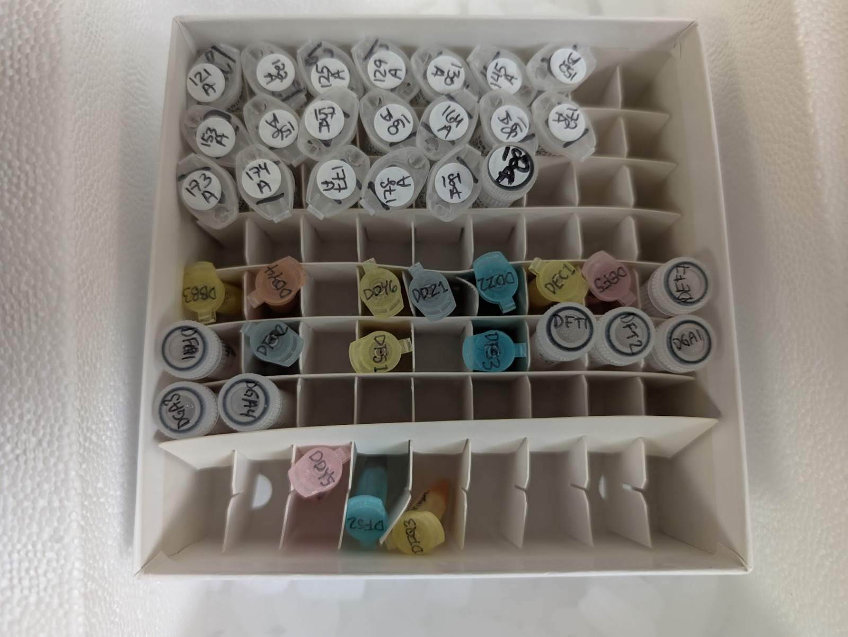
Confounders: Tube differences are always a concern
Experiments need to be designed from the start to minimize confounders
Common confounders
  Different individuals collecting samples
  Animals from different litters or Jax shipments
  Change in diet or housing
  Different SOPs for collecting plasma
  Animals housed differently
Tube differences indicate likely confounders not associated with what is be tested

Slide 2
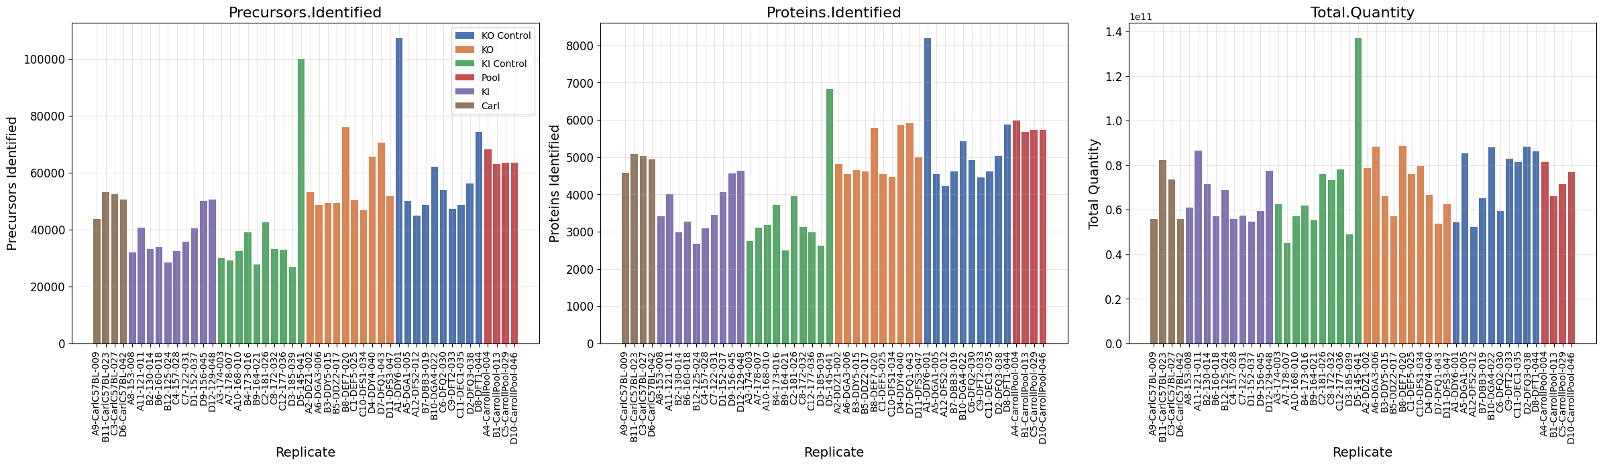
Peptide Precursors, Proteins, Total Sigal

Slide 3
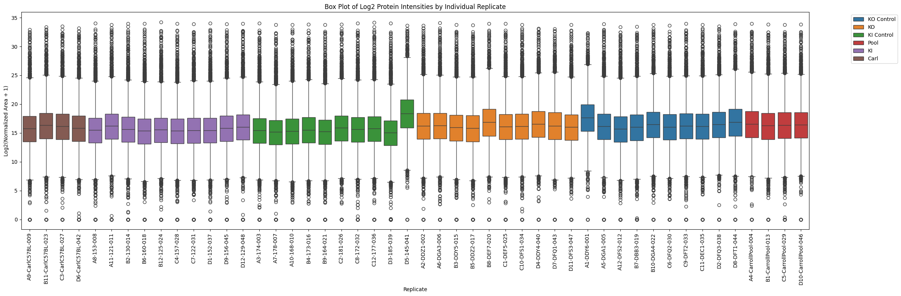
Unnormalized Signal Intensity

Slide 4
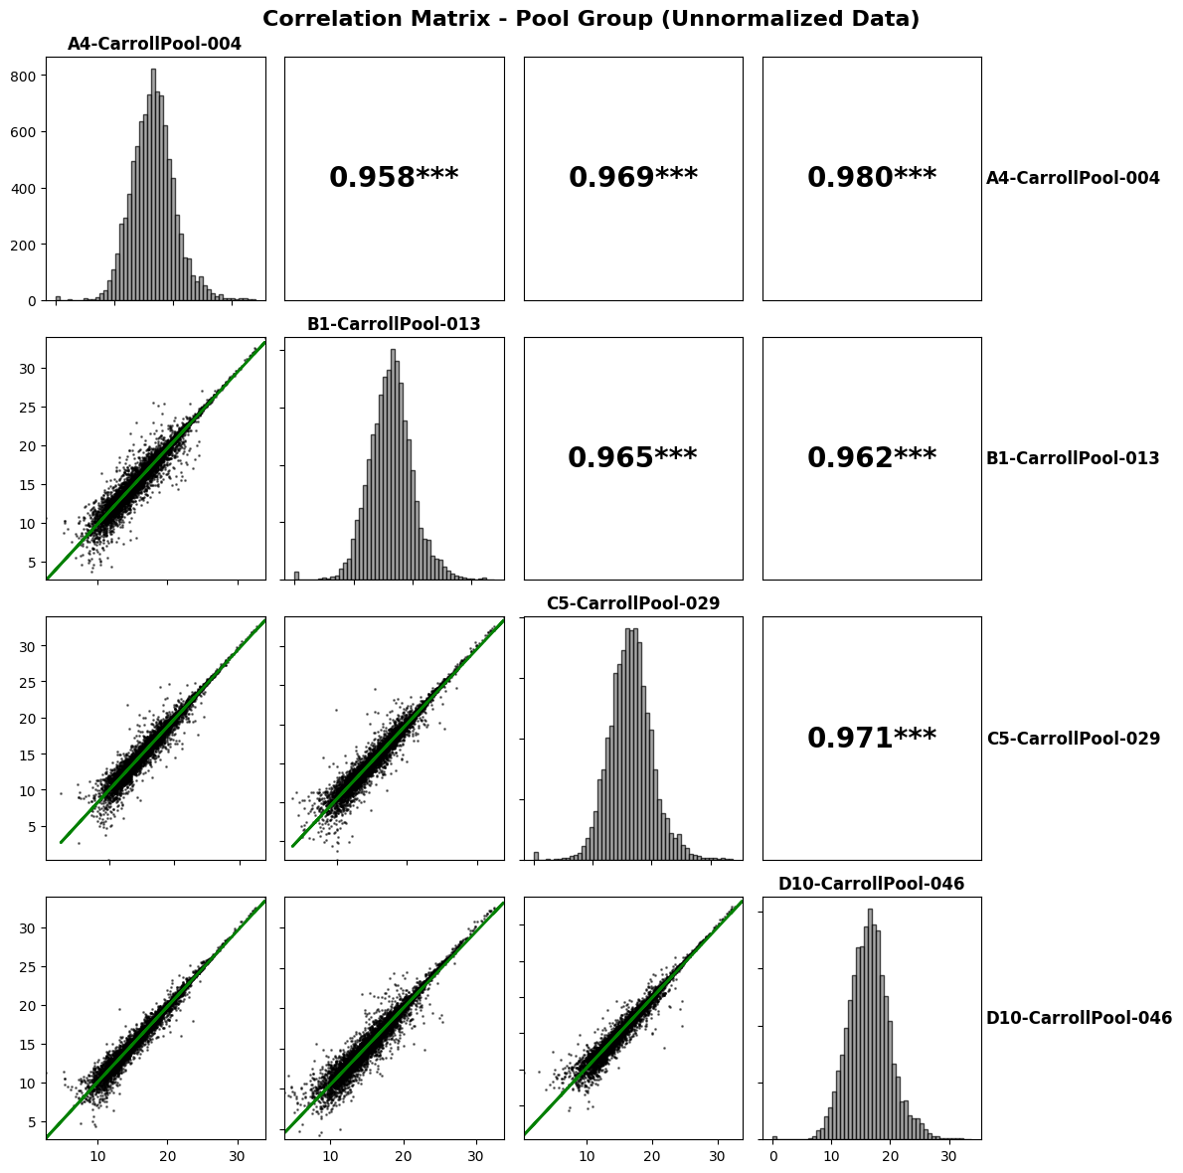
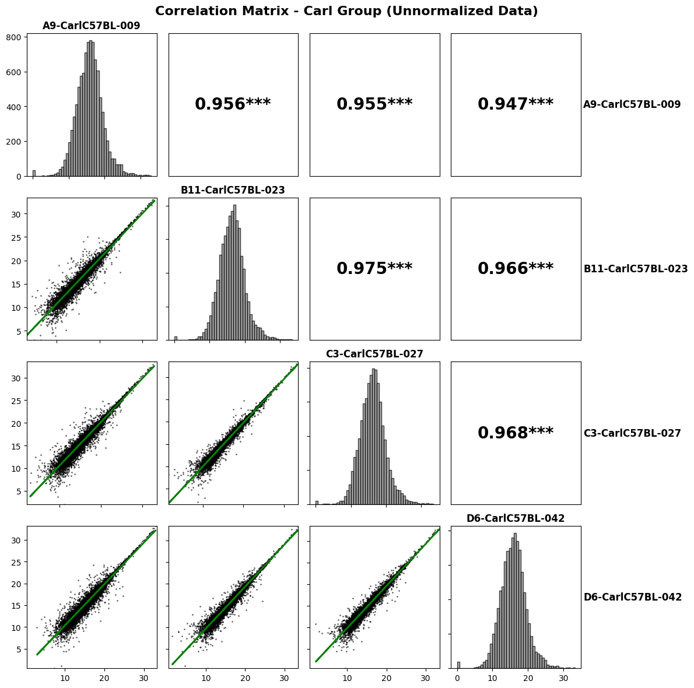

Slide 5
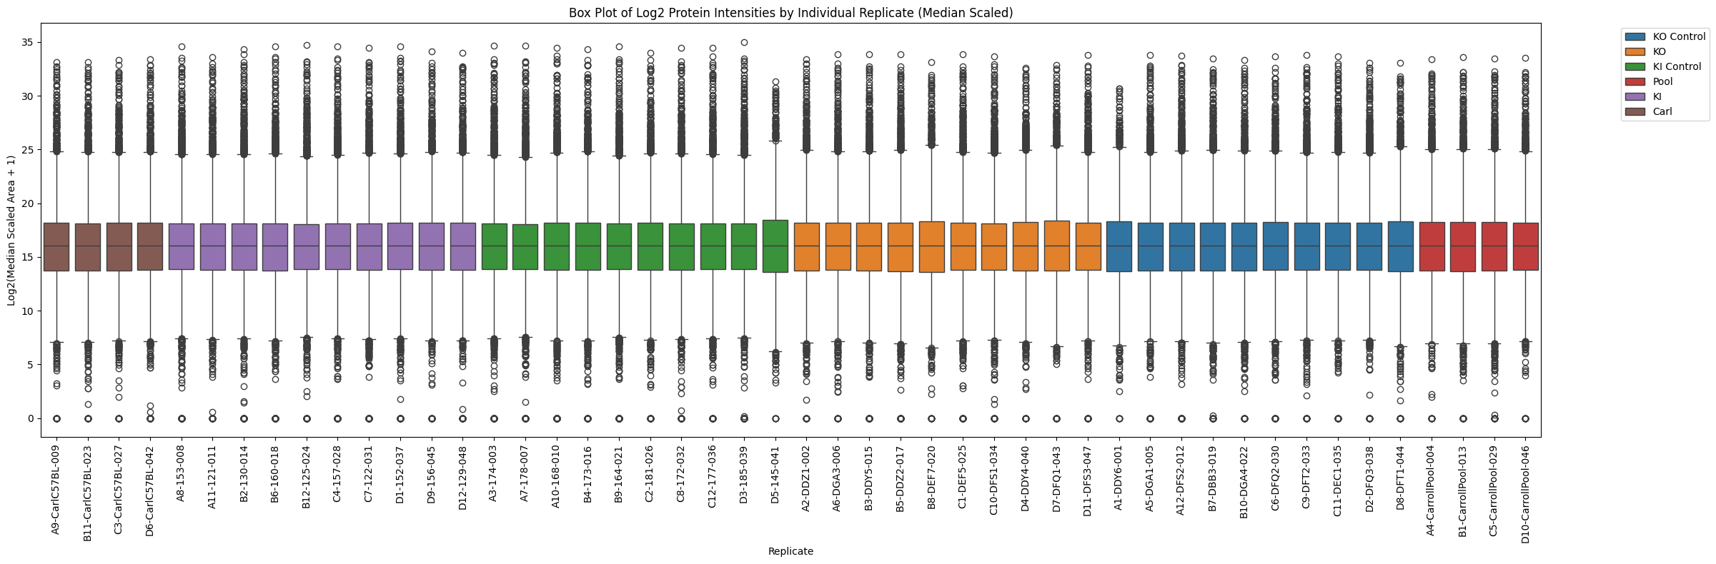
Median Scaled Signal Intensity

Slide 6
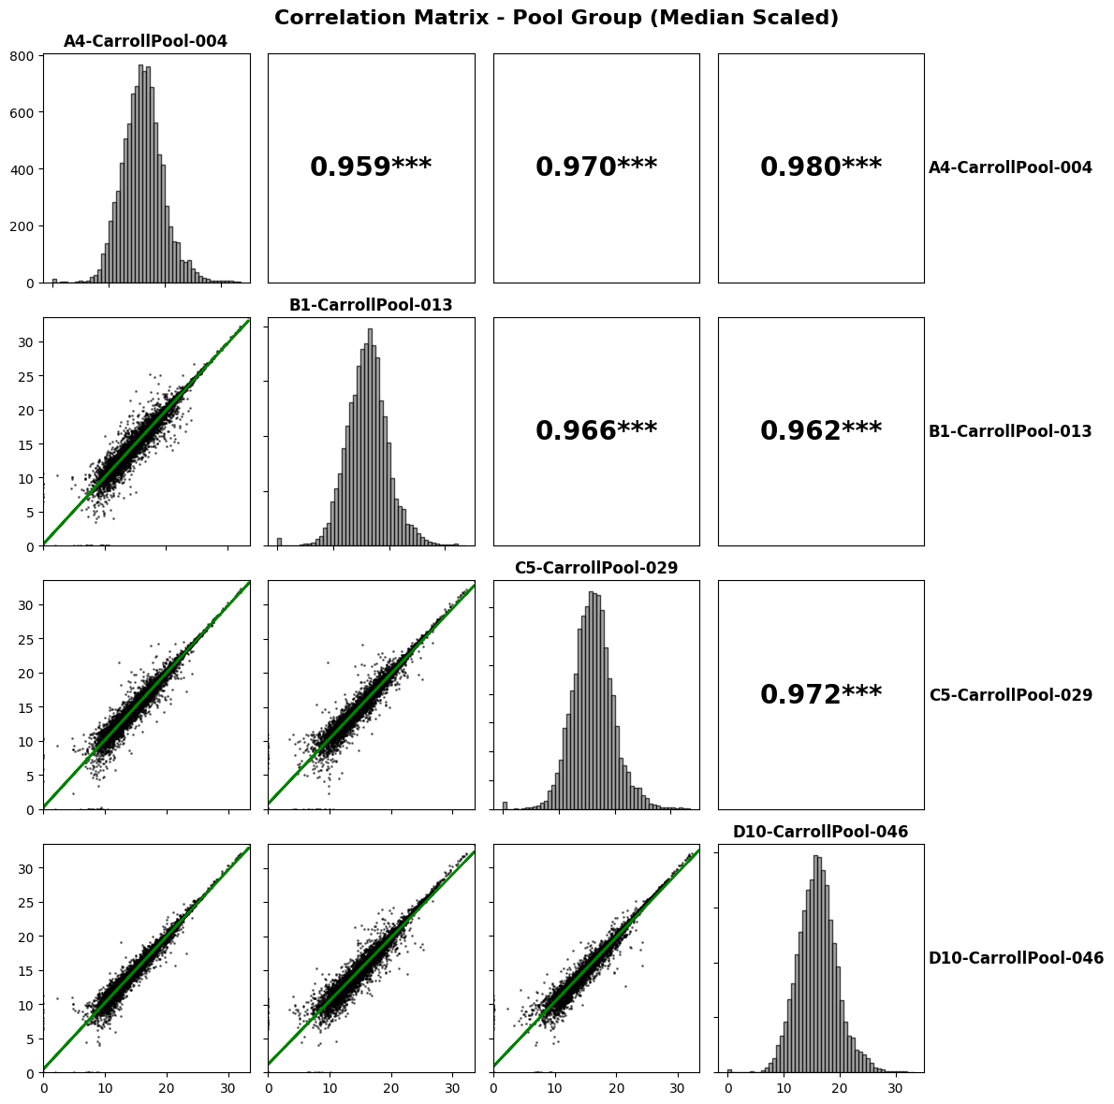
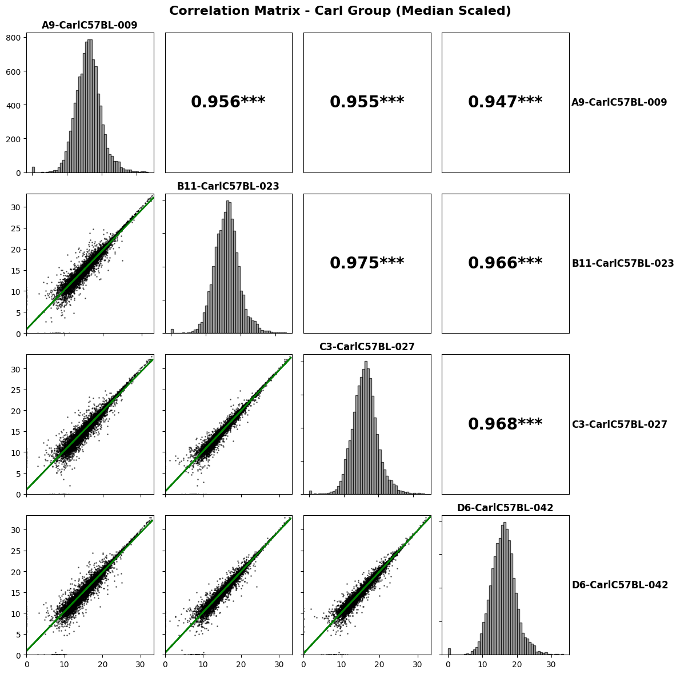

Slide 7
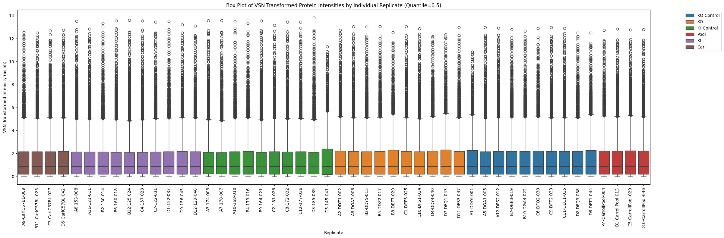
VSN Normalized Signal Intensity

Slide 8
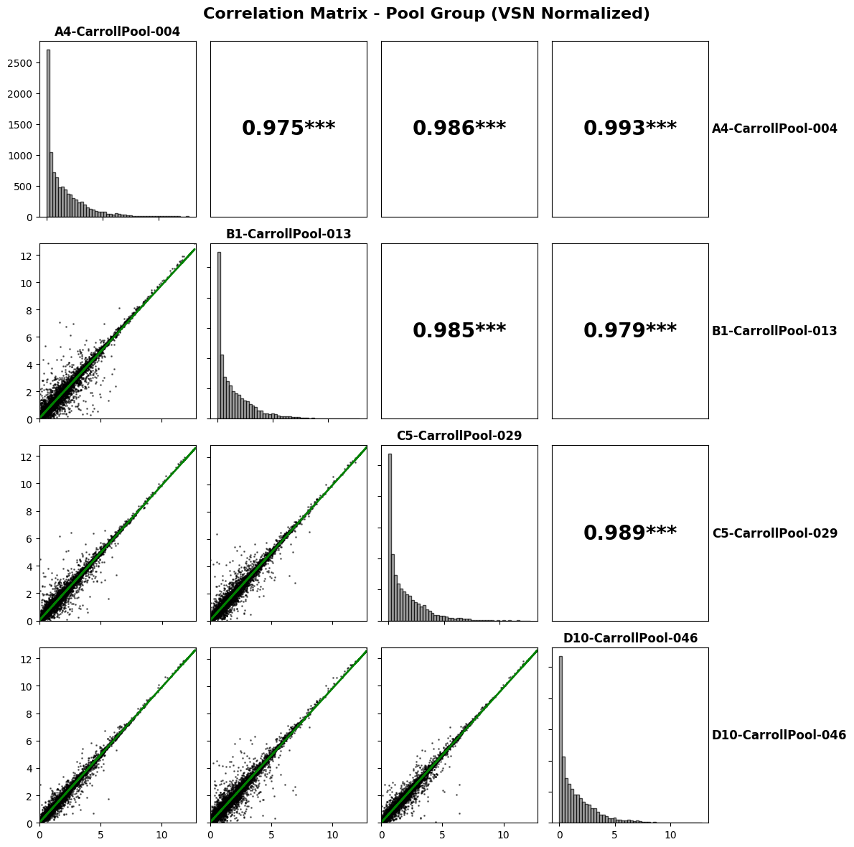
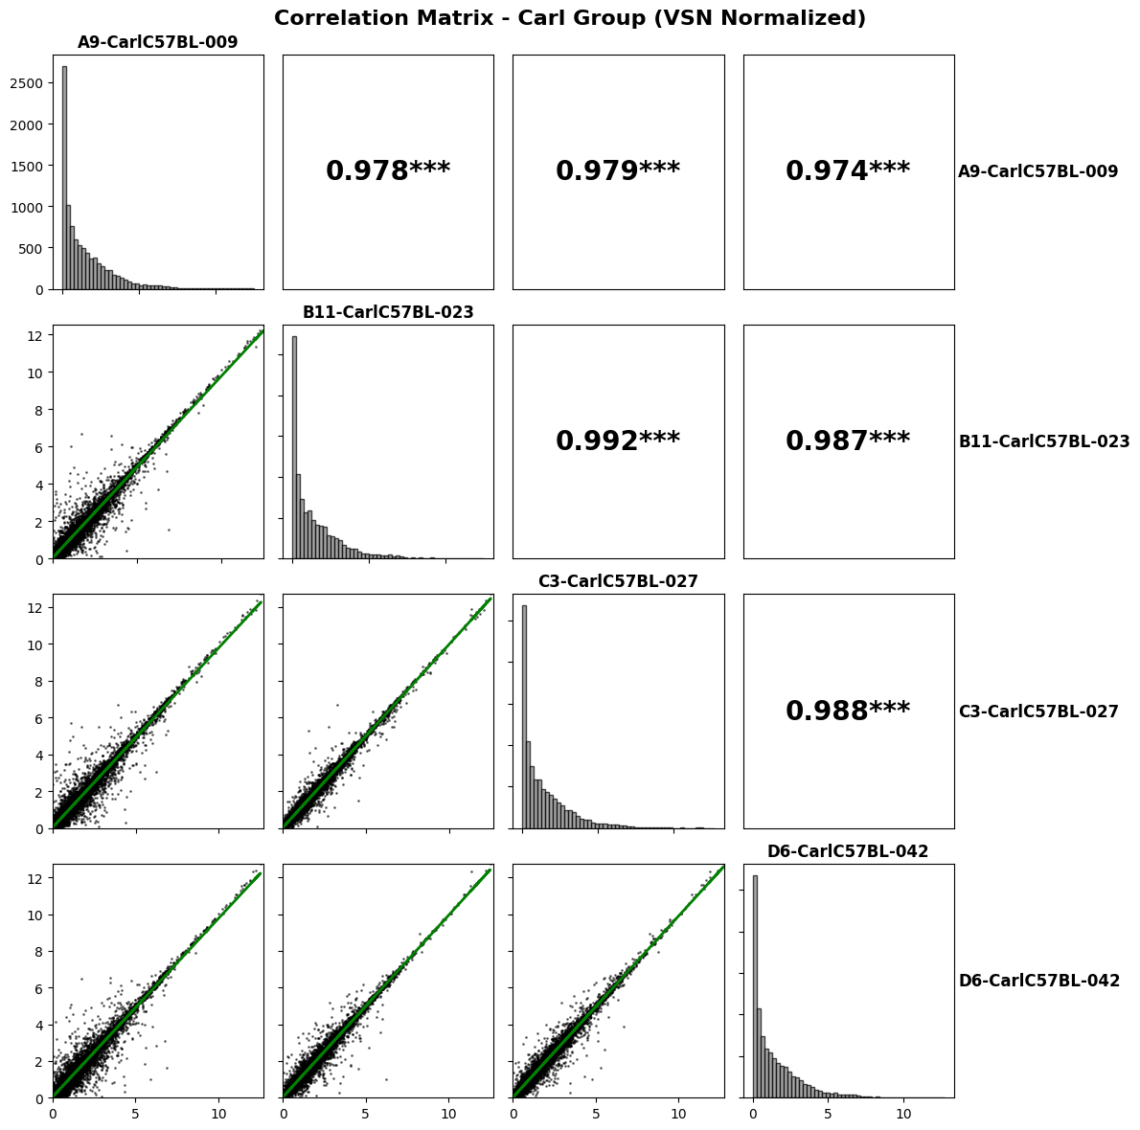

Slide 9
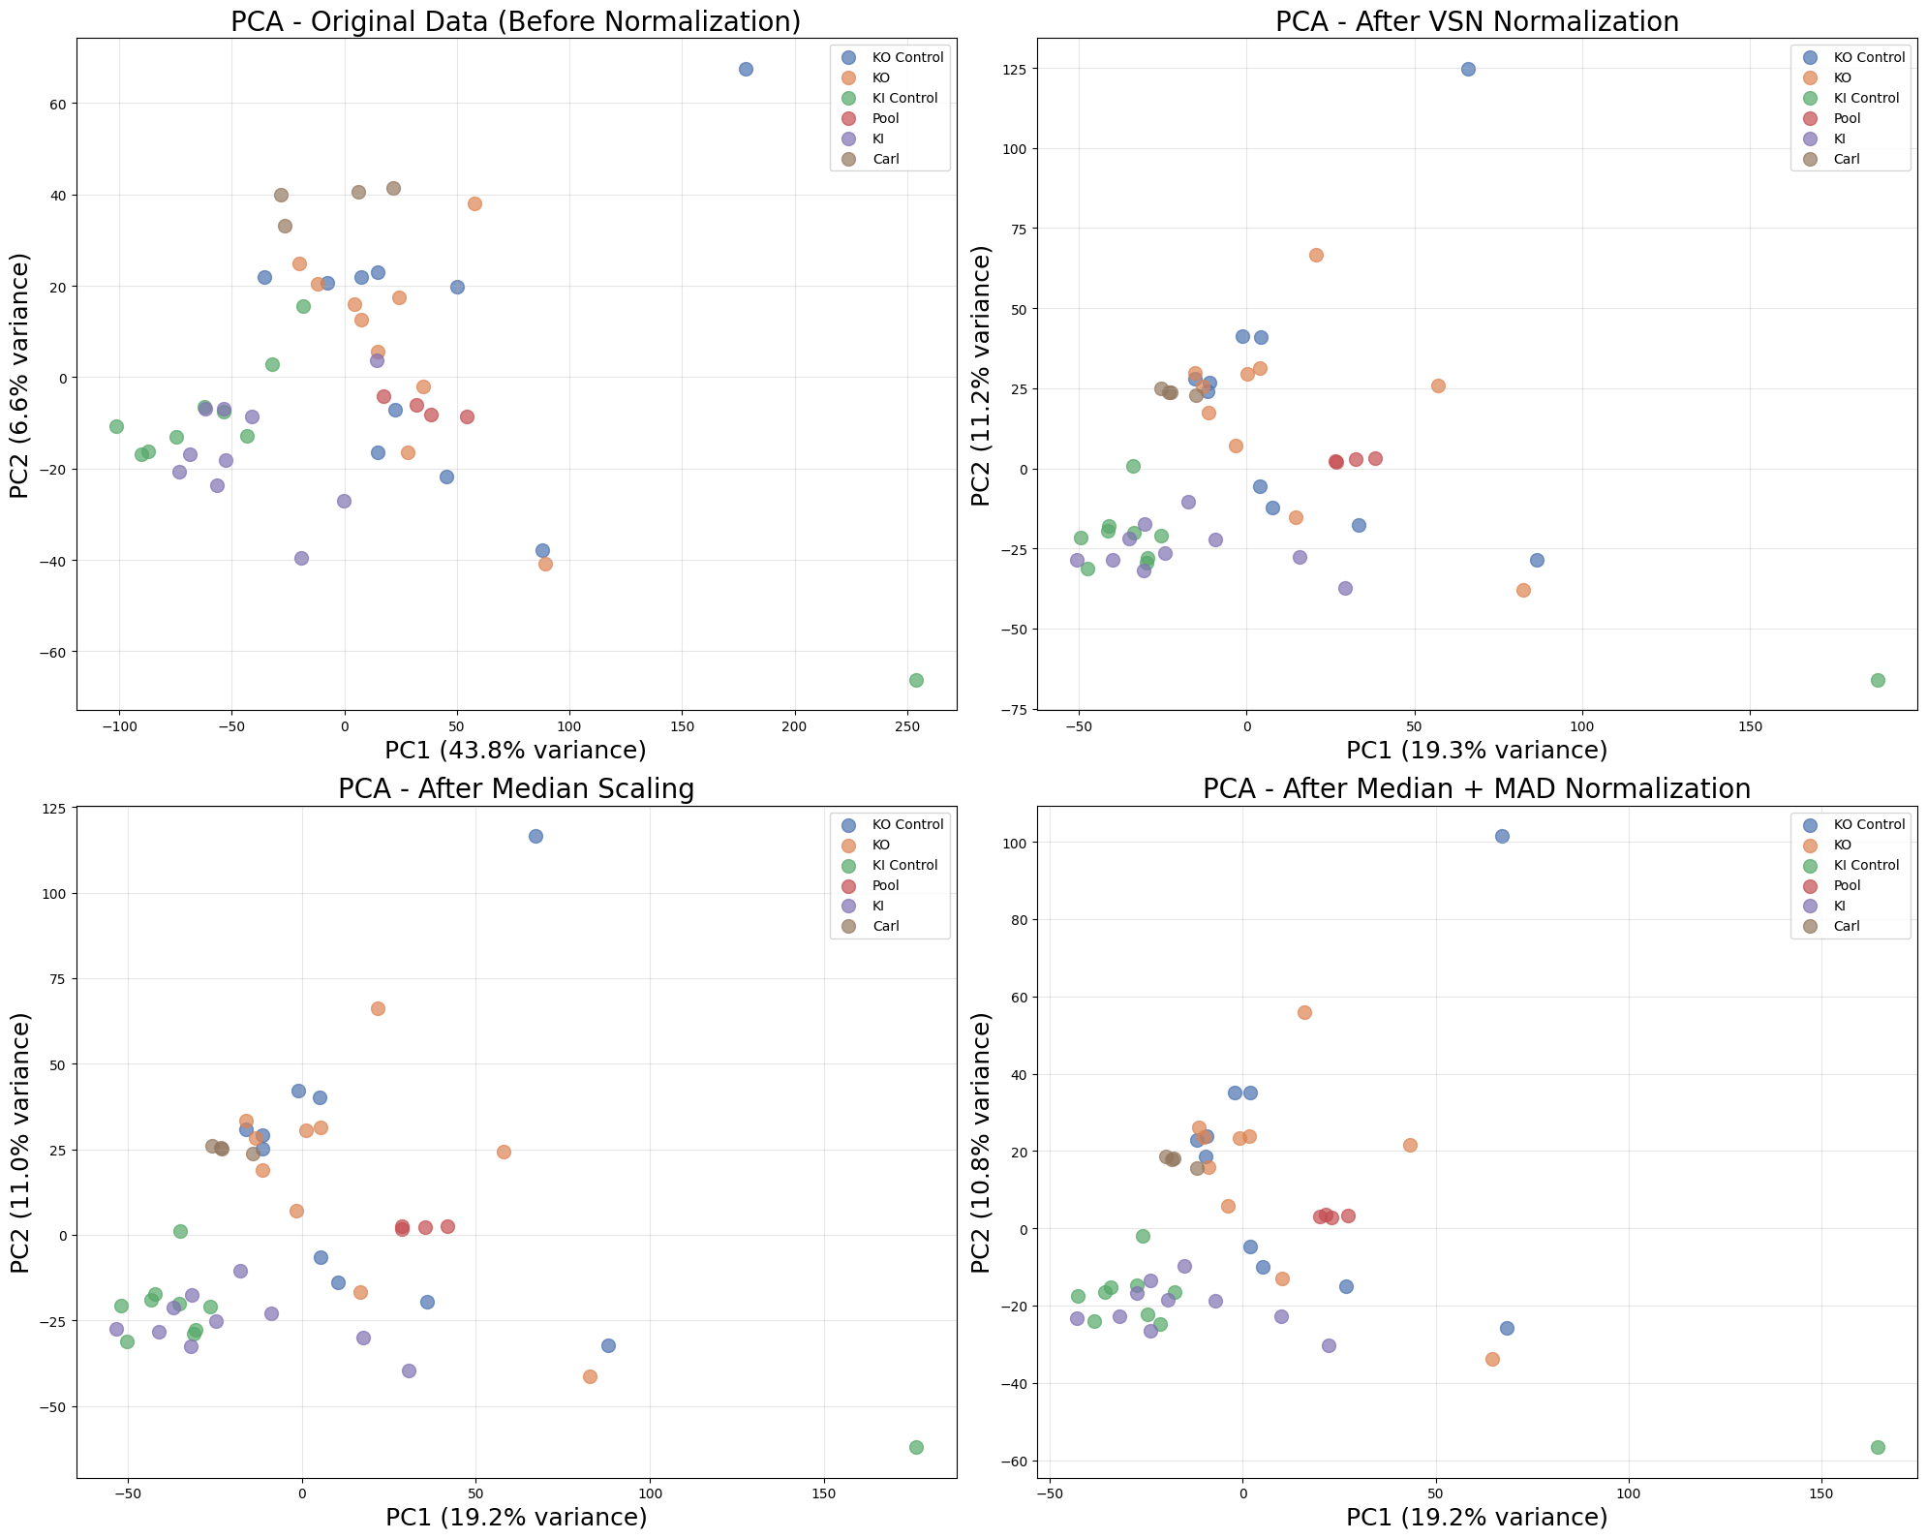

Slide 10
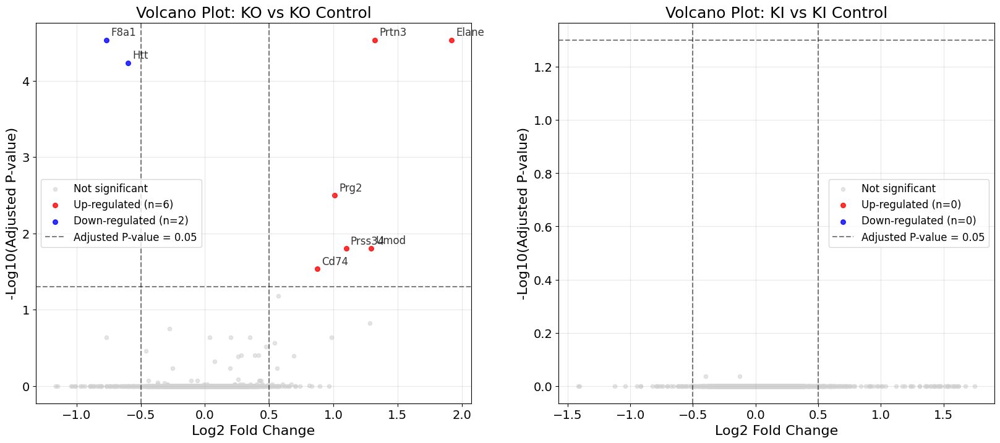
Differential abundance of VSN normalized data

Slide 11
KO vs KO Control
============================================================
DIFFERENTIAL ANALYSIS: KO vs KO Control
============================================================
Comparing KO (n=10) vs KO Control (n=10)
Total proteins tested: 9528
Significant proteins (BH p-adj <= 0.05): 8
Significant proteins:
Gene Log2FC P_value P_adj
3824 F8a1 -0.766289 6.756639e-09 0.000029
6322 Prtn3 1.322543 7.301486e-09 0.000029
837 Elane 1.920876 9.221062e-09 0.000029
4279 Htt -0.598272 2.451299e-08 0.000058
1911 Prg2 1.011588 1.668845e-06 0.003180
5342 Umod 1.296221 9.841251e-06 0.015628
7656 Prss34 1.100332 1.161770e-05 0.015813
8421 Cd74 0.873370 2.453857e-05 0.029225

Slide 12
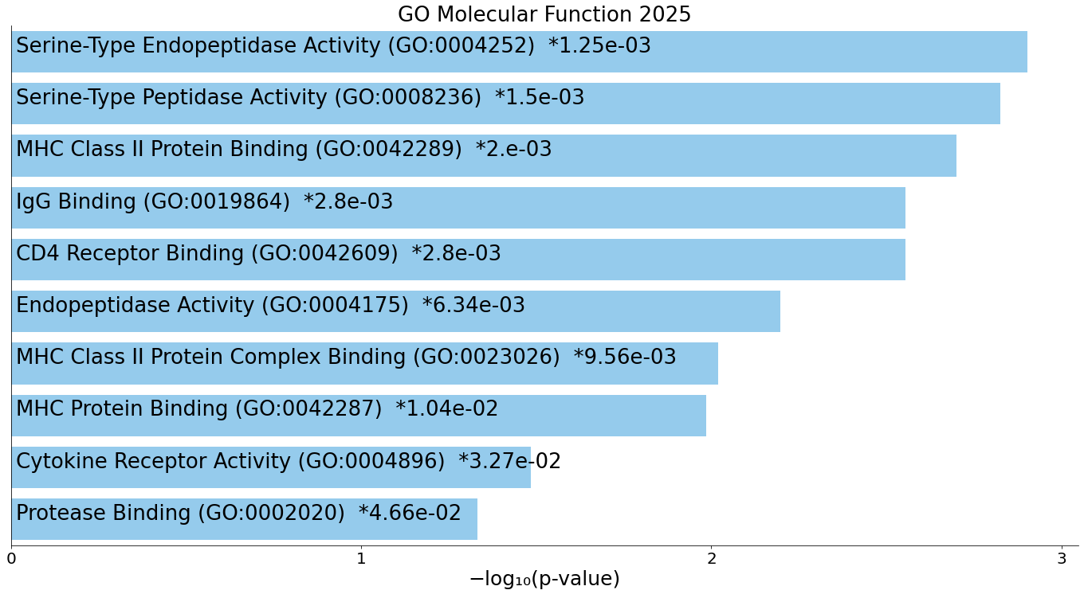

Slide 13
KI vs KI Control
============================================================
DIFFERENTIAL ANALYSIS: KI vs KI Control
============================================================
Comparing KI (n=10) vs KI Control (n=10)
Total proteins tested: 9528
Significant proteins (BH p-adj <= 0.05): 0
No proteins with BH corrected p-value <= 0.05
Top 10 most significant proteins:
Gene Log2FC P_value P_adj
5307 Eif3b -0.397272 0.000169 0.920558
3515 Gdf11 -0.125892 0.000193 0.920558
9522 Sh3d19 0.006573 0.280557 0.999500
9521 Pofut2 -0.031270 0.665995 0.999500
16 Clul1 -0.021754 0.588689 0.999500
17 Chsy3 -0.139647 0.550304 0.999500
18 Flot2 -0.067006 0.371486 0.999500
19 P4ha2 0.046342 0.829517 0.999500
20 Apoc4 0.094125 0.520941 0.999500
21 Sdc3 0.005338 0.653569 0.999500

Slide 14
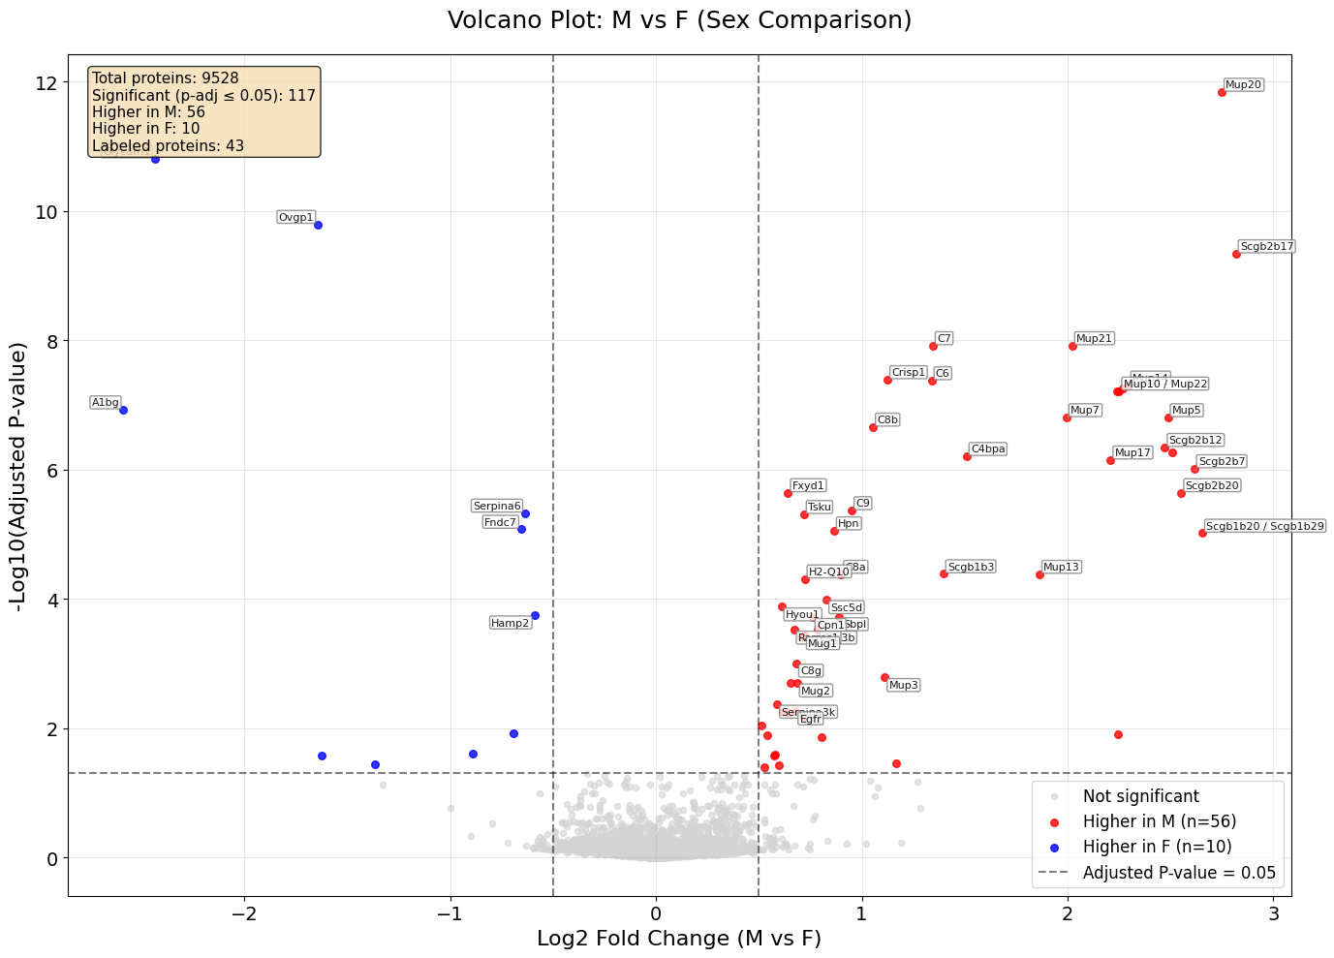
Having both sexes complicates the analysis and reduces the power

Slide 15
M vs F
============================================================
DIFFERENTIAL ANALYSIS: M vs F (Sex comparison)
============================================================
Available sex annotations: Sex
F 20
M 20
Name: count, dtype: int64
Samples with sex annotation: 40
Comparing M (n=20) vs F (n=20)
Total proteins tested: 9528
Significant proteins (BH p-adj <= 0.05): 117

Slide 16
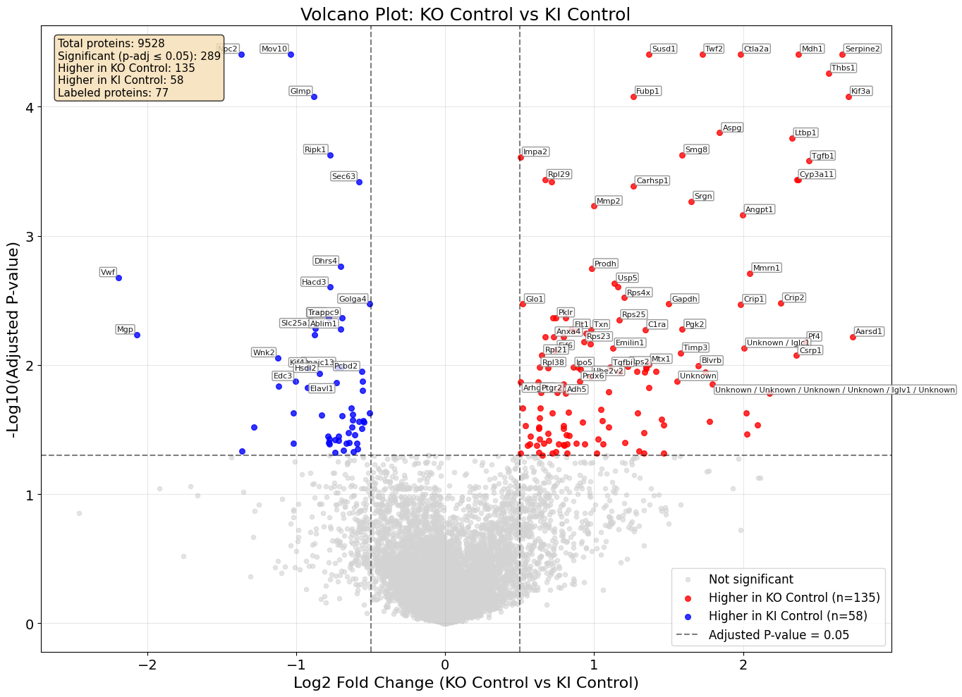
The controls are very different

Slide 17
KO Control vs KI Control
============================================================
DIFFERENTIAL ANALYSIS: KO Control vs KI Control
============================================================
Comparing KO Control (n=10) vs KI Control (n=10)
Total proteins tested: 9528
Significant proteins (BH p-adj <= 0.05): 289
Significant proteins:
Gene Log2FC P_value P_adj
3079 Mov10 -1.040569 2.782622e-08 0.000039
6228 Ctla2a 1.984779 2.872918e-08 0.000039
3209 Susd1 1.366642 1.153712e-08 0.000039
3127 Mdh1 2.372697 1.924230e-08 0.000039
9384 Twf2 1.725053 2.484805e-08 0.000039
6659 Serpine2 2.664271 1.406535e-08 0.000039
7493 Npc2 -1.370486 9.700025e-09 0.000039
6410 Thbs1 2.575684 4.633890e-08 0.000055
1302 Fubp1 1.264028 8.448693e-08 0.000083
5223 Glmp -0.880826 8.837387e-08 0.000083
919 Kif3a 2.707955 9.595656e-08 0.000083
4555 Aspg 1.842999 2.005192e-07 0.000159
8889 Ltbp1 2.327079 2.388243e-07 0.000175
7144 Smg8 1.591362 3.704987e-07 0.000235
6142 Ripk1 -0.774911 3.602067e-07 0.000235
4061 Impa2 0.505411 4.127678e-07 0.000246
6493 Tgfb1 2.440645 4.690129e-07 0.000263
5191 Rpl29 0.669972 7.317083e-07 0.000367
4207 Cyp3a11 2.360133 7.119262e-07 0.000367
8018 Cyp3a44 2.369265 7.705928e-07 0.000367

